Slide 1
16 Days and 16 Fallacies II
The Metaphysics of Human Origins

Slide 2
Continuing Comments on Smith and Brogaard
Barry Smith, Berit Brogaard:
Sixteen Days
Journal of Medicine and Philosophy. In Press.

Slide 3
The Ontological Significance
Interesting for biological and medical issues
Interesting for philosophical issues:
The case of Personal Identity

Slide 4
The Case of Personal Identity
Some theories (e.g. John Perry's) are parasitic upon an answer to the question of when a human being stage is diachronically identical with another human being stage.

Slide 5
The Circularity Objection
Any account in terms of memory will necessarily be viciously circular, since memory presupposes personal identity and therefore cannot be used to define it.

Slide 6
M-type Causal Chains
To identify the right kind of causal chain, the personal identity theorist has to point to a contingently obtaining causal connection in the real world, the connection an overwhelming number of diachronically identical human being stages instantiate whenever later stages have reliable memories of experiences the same human being had earlier in its life.

Slide 7
A Problem of Identity
The problem what the conditions of diachronic identity of an object of some kind are is often confused with the problem what conditions determine the kind-membership of objects of that kind.

Slide 8
The Problem of Smith/Brogaard
When does an entity belong to the kind human being?

Slide 9
Same Question?
(Q1) When does a human being begin to exist?
(Q2) At what stage is the foster first transtemporally identical to the human being as it exists after birth?
This is not the same question!

Slide 10

Amoeba?
Entities which undergo substantial changes don't thereby necessarily change their kind-membership.

Slide 11
Fission
Fission is distinct from separation in that, when an entity (for example a virus) undergoes fission, new parts are formed which then split apart to lead separate existences. [...] Fission gives rise to new entities and destroys the entity which existed earlier.

Slide 12
Fission and Gastrulation
Fission is no longer possible from gastrulation onwards. This is taken to be one strong reason "to believe that an account of the beginning of human existence as lying within the gastrular phase is more than a mere definitional or conceptual stipulation".

Slide 13
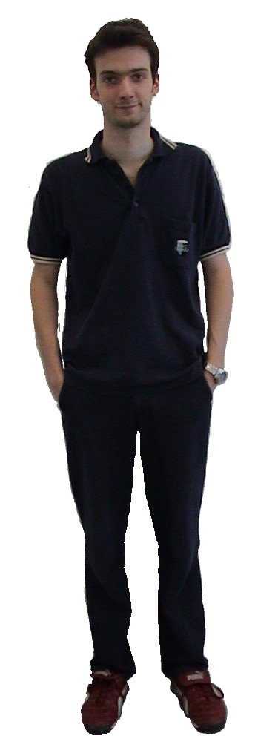

What is the problem with potential fission?
16 Days and 16 Fallacies
Comments on Smith and Brogaard

Slide 14
An Argument from Potential Fission
(1) Fission gives rise to new entities and destroys the entity which existed earlier. (Premise)
(2) Entities that came into existence through the fission of an earlier entity are not identical with this earlier entity. (From 1)
(3) If an entity at some time t₁ is identical with some entity at some later time t₂, this is necessarily so. (Necessity of identity)
(4) If there is an entity at t₂, and there is an entity which is a candidate for identity therewith at some earlier time t₁, and it is possible for this latter entity at t₁ to split during the interval t₁–t₂, then it is possible that the entity at t₂ is not identical with the entity at t₁. (From 3, and 2, and symmetry of the identity relation)
(5) If it is possible that the entity at t₁ and the entity at t₂ are not identical, they are not identical. (From 3)
(6) If there is an entity at t₂, and there is a candidate for identity with it at some earlier time t₁, and it is possible for this entity at t₁ to split during the interval t₁–t₂, then the entities at t₁ and t₂ are not identical. (From 4 and 5)

Slide 15
The Amoeba Problem
Either
(AP) Entities which have the potentiality to split (to undergo fission), do not persist over time.
is true, or potential twinning is no reason whatsoever "to believe that an account of the beginning of human existence as lying within the gastrular phase is more than a mere definitional or conceptual stipulation", it's just some change without further ontological significance.

Slide 16
The Only x and y principle
If two events are parts of the history of a single entity in one situation then they must also be parts of the history of a single entity of a kind in any second situation in which, as judged by the Cambridge criterion (which excludes mere Cambridge differences between two situations), both they, and all the events which are parts of the history of the entity in the first situation remain present.

Slide 17
No help from a weaker relation
Smith/Brogaard can endorse some weaker relation than identity, but then their account of fission will get them into trouble with the Only x and y principle.

Slide 18
Sorites
"It seems difficult to conceive of any abrupt threshold associated with the transition to consciousness that would constitute a substantial change in the organism considered as a whole."

Slide 19
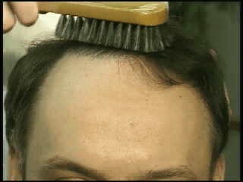
Sorites - We'll never become bald
The fact that there is no abrupt threshold but only clear cases at the outer areas of a continuous spectrum does not keep us from drawing a sharp boundary somewhere in the penumbra at will, otherwise we could never become bald by losing individual hairs.

Slide 20
Changes in parts and changes in wholes
A substantial change in a part of us, namely in the brain, determines that substantial change which is the end of our existence.
To claim that a partial change cannot mark a substantial change in me as a whole is, without further argument, question begging.

